Slide 1
NEER – SMART WATER METER
Cisco thingQbator
Demo Day

Slide 2
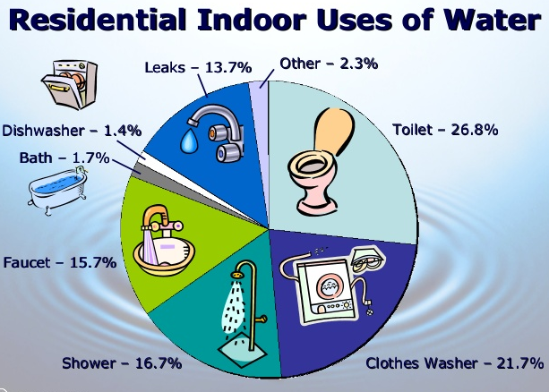
Problem Statement
India is facing its worst-ever water crisis, with some 600 million people facing acute water shortage.
Many end up relying on private water suppliers or tankers paid for the by the government.
As cities and towns grow, the pressure on urban water resources is expected to increase - the report estimates that demand will be twice as much as available supply by 2030.

Slide 3
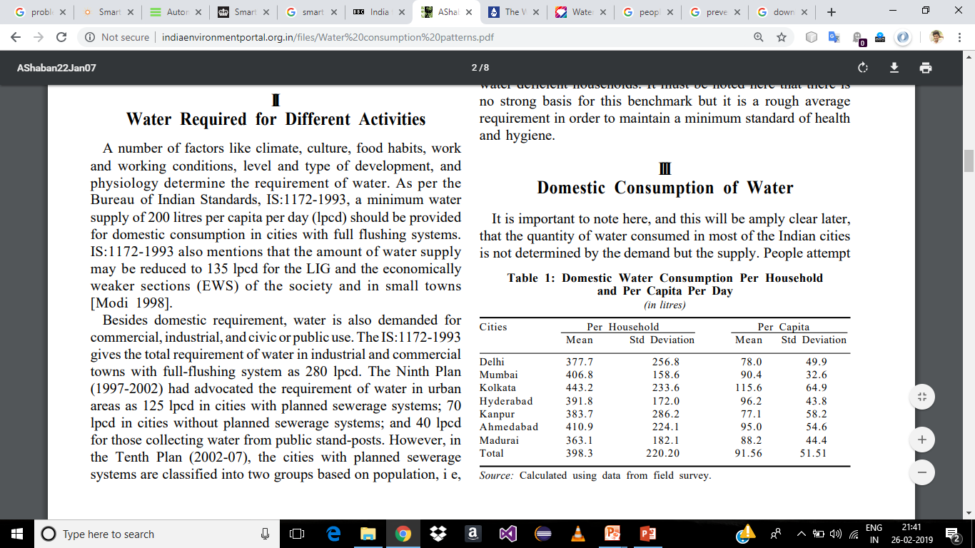
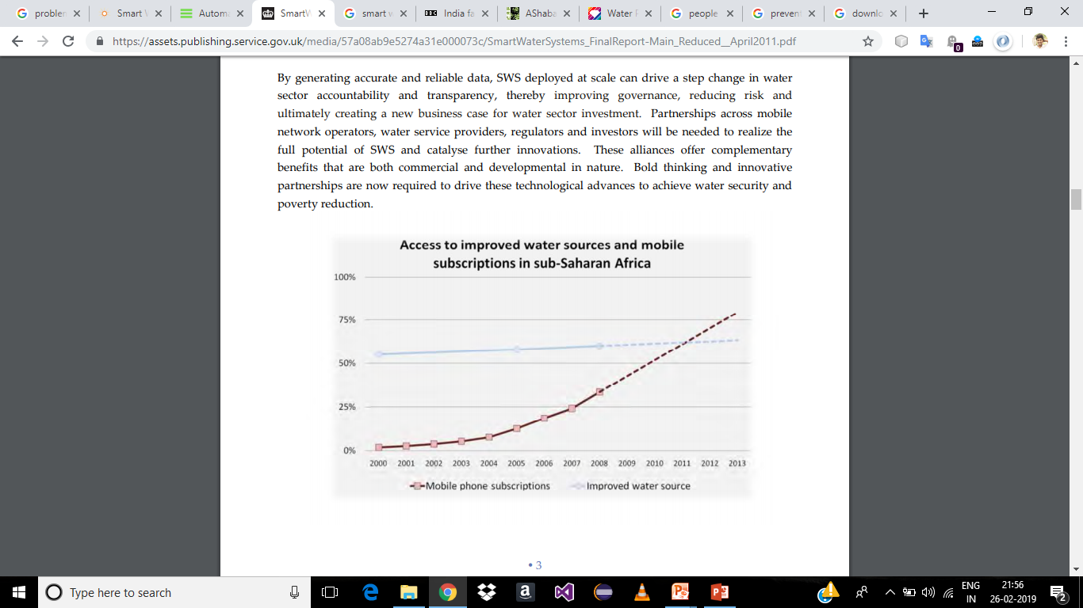
Problem Statement
For the time being water is subsidised in India, but who says it will be so, in a span of 5-10 years. As the saying goes “There is no use of crying over split milk”, so it is high time we start to save water.

Slide 4
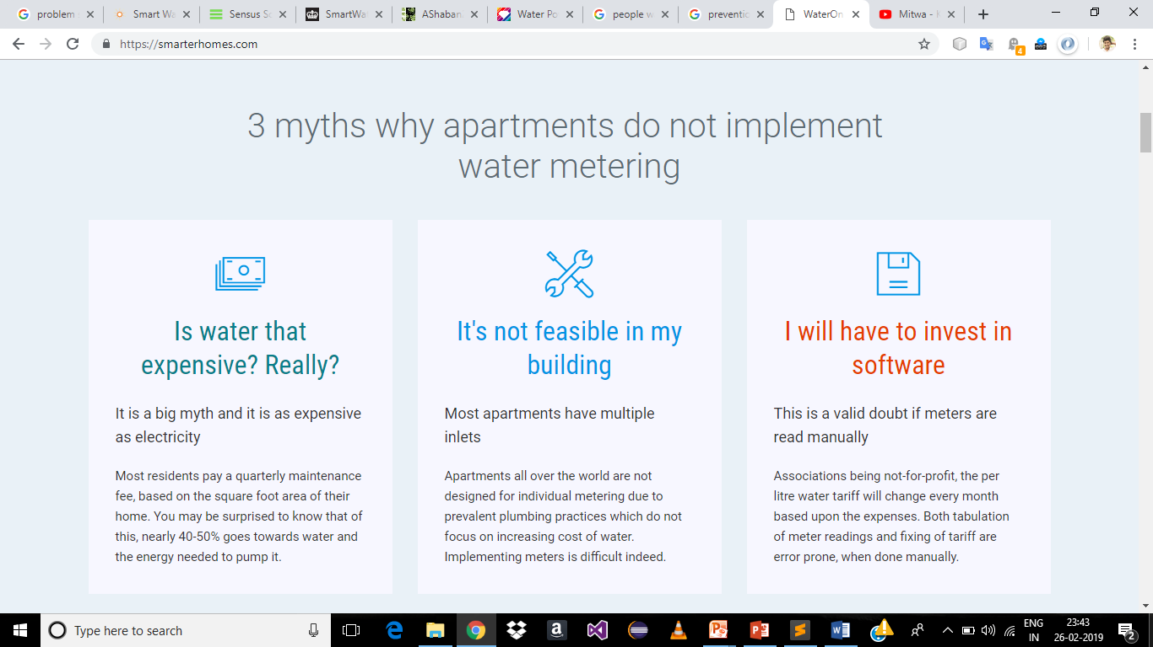
3 myths why apartments do not implement water metering

Slide 5
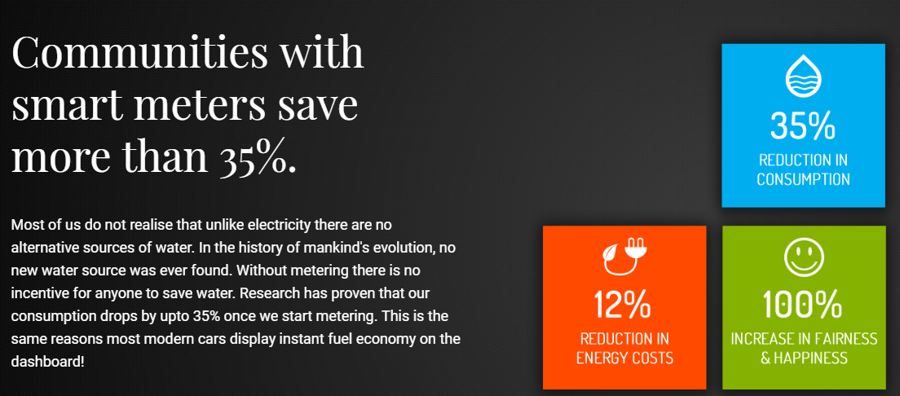
Statistics

Slide 6
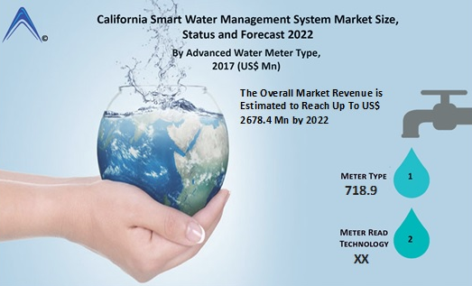
Existing Plans
EVWD entered into a $2m deal with water works equipment supplier Equarius Waterworks of Torrance to deploy an AMI project
The five-year contract allows the California state water utility to replace existing water meters with smart meters to ensure accurate billing as well as to help customers to reduce their water usage and costs
The project will be funded by a loan granted the local water district by the California Department of Water Resources

Slide 7

NEER - Smart Water Meter
Smart Water Metering System aims to give consumers the information that they need to make intelligent decisions, the ability to execute those decisions and a variety of choices leading to substantial benefits they would not have enjoyed otherwise.
Our Primary focus:
To track the consumed quantity
To ensure safety
To detect leaks

Slide 8
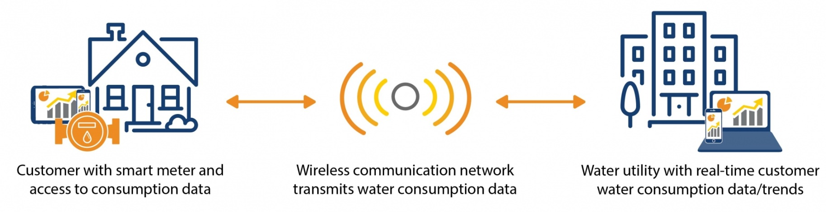
Old mechanical meters degrade over time and may fail to provide accurate measurement readings.
Benefits:
Timely water usage data
Water revenue optimization
Scalable
Water leak detection

Slide 9
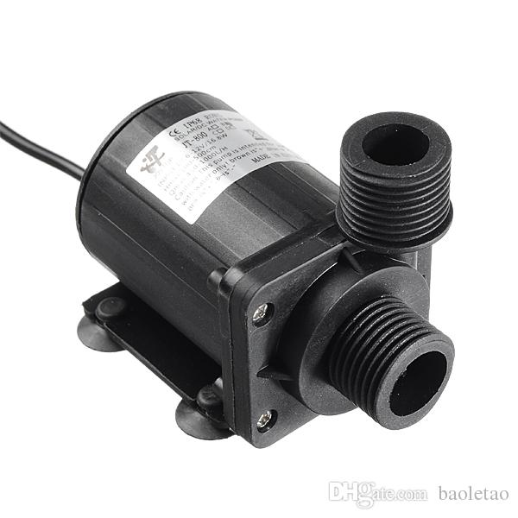
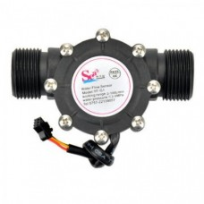
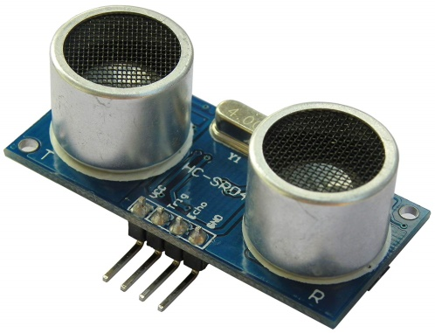
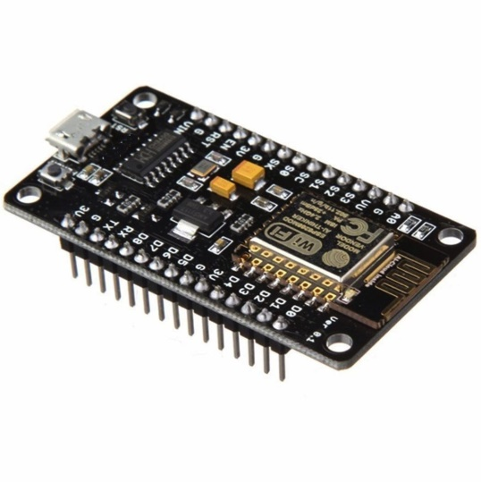
Hardware Requirements
Our Primary focus:
NodeMCU
Mechanical Flow Sensor
Ultrasonic Sensor
Arduino GSM Shield

Slide 10
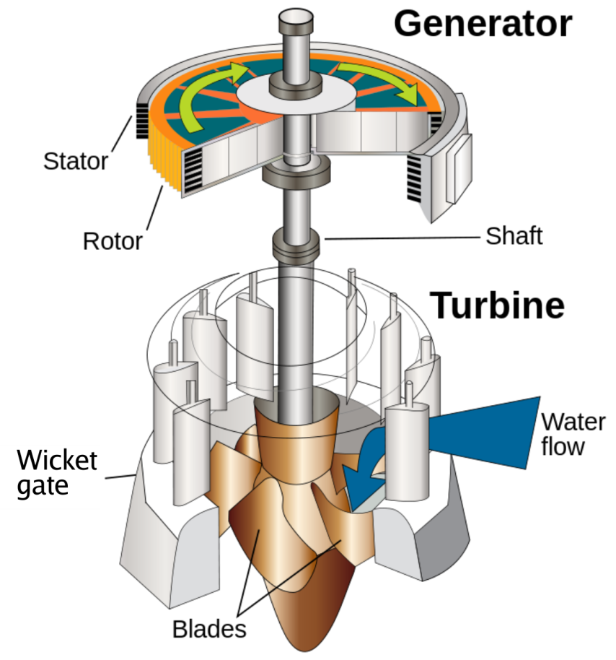
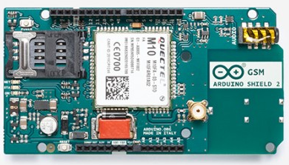
Wi-Fi Availability and Power

Slide 11
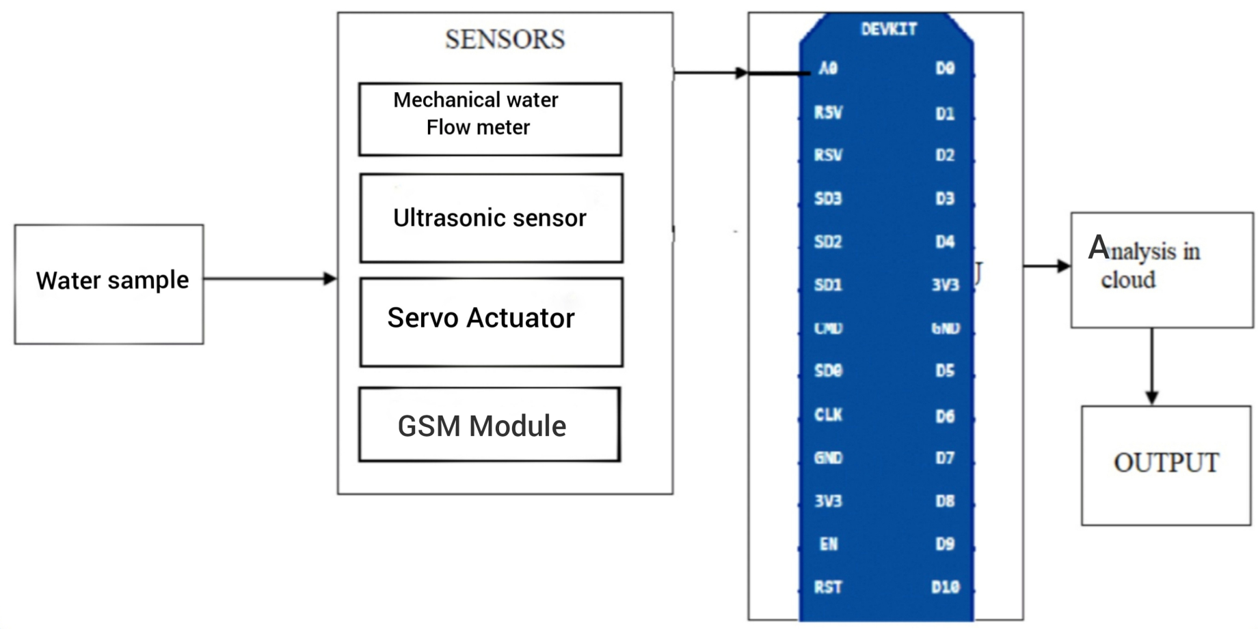
Hardware Design

Slide 12
Software Requirements
Arduino IDE
Google Firebase
Python Visualization
Android Studio

Slide 13
Reference Model
Physical Devices | Mechanical Flow Sensor, Ultrasonic sensor, Arduino GSM Shield .
Connectivity | Sensors connected to Node MCU which is connected to cloud via WiFi Module
Edge Computing | Node MCU uses the received data and Analysis is done in cloud.

Slide 14
Reference Model
Data Accumulation | The data is uploaded in Google Firebase.
Data Abstraction | Console is provided to the users to find the quantity of water used by them.
Application | Application which displays the quantity and parameters

Slide 15
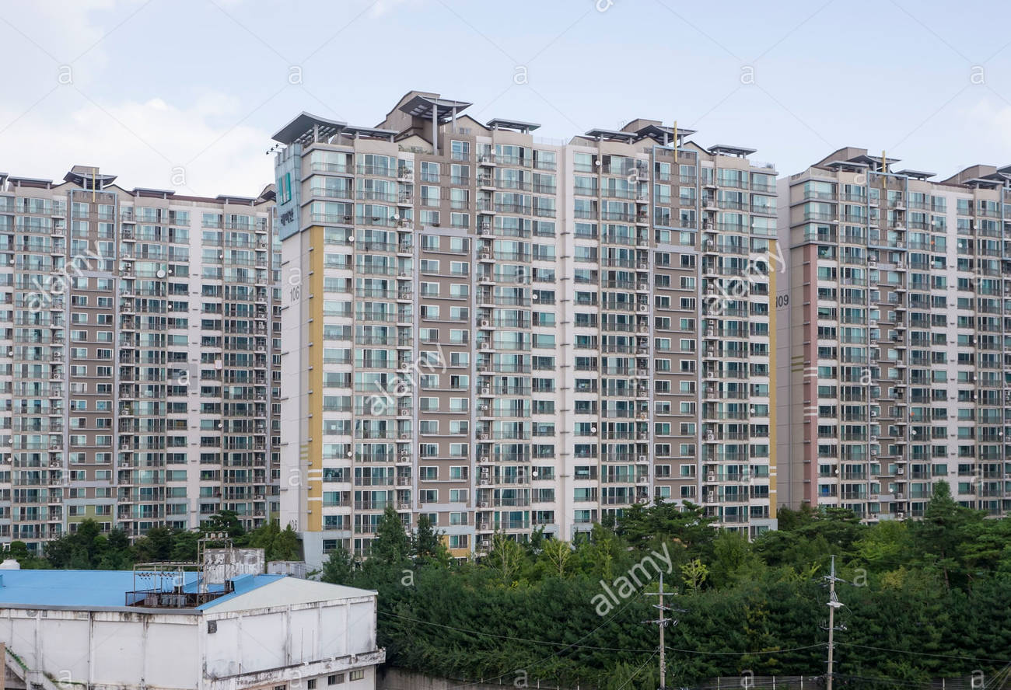
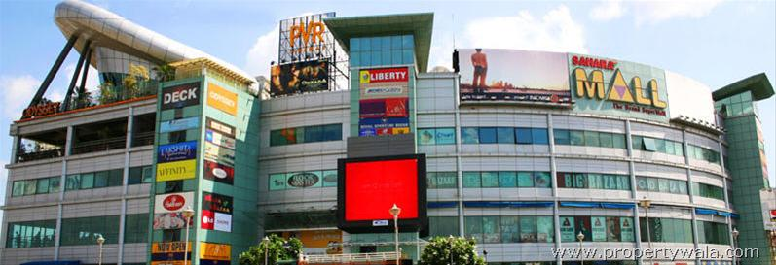
Target Audience
Large Flats and societies
Big malls
Tamil Nadu Government

Slide 16

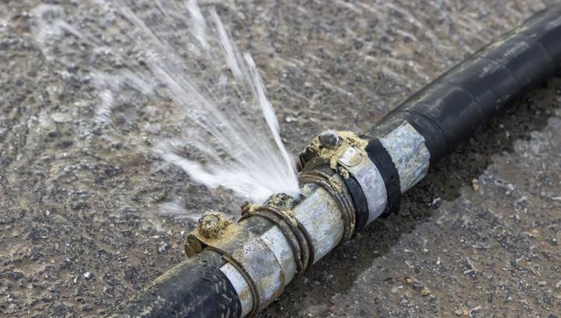
Future
Using smart water meter, usage pattern can be found.
The data obtained can be analysed using Machine Learning which will be helpful for water resource planning
Proper implementation of water leak detection.

Slide 17
THANK YOU
By
Neeraj Menon S
K.Rohith Kumar
Roshan R Bhat
Hamad Yousuff

